Slide 1
Sales Data Analysis
Task 4 – Data Storytelling & Statistical Validation
Presented by: Keesara Yashaswini

Slide 2
Project Objective
• Analyze the sales dataset to understand customer purchasing behavior and business performance.
• Perform data cleaning and preprocessing to prepare high-quality data for analysis.
• Conduct Exploratory Data Analysis (EDA) to identify trends, patterns, and relationships.
• Build an interactive Power BI dashboard for effective business visualization.
• Validate a business insight using statistical hypothesis testing.
• Provide actionable business recommendations based on the analysis.
Data Collection
↓
Data Cleaning
↓
EDA & SQL Analysis
↓
Power BI Dashboard
↓
Hypothesis Testing
↓
Business Recommendations

Slide 3
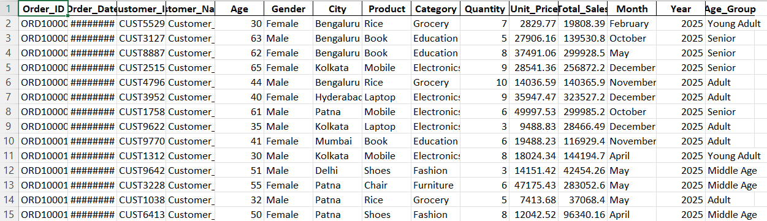
Dataset Overview
Dataset Overview Dataset Type : Retail Sales Dataset Purpose : Analyze customer purchasing behavior and overall sales performance.
Key Attributes
• Order ID •Quantity
• Customer ID •Unit Price
• Product •Total Sales
• Category •Month
• Gender •Year
• City •Age Group

Slide 4
Data Cleaning & Preprocessing
✔ Checked missing values ✔ Removed duplicate records ✔ Verified data types ✔ Formatted Order Date ✔ Created Month, Year & Age Group columns ✔ Saved cleaned dataset
Converted the Order_Date column to a proper date format.
Created new features:
Month
Year
Age_Group
Saved the cleaned dataset for further analysis.

Slide 5
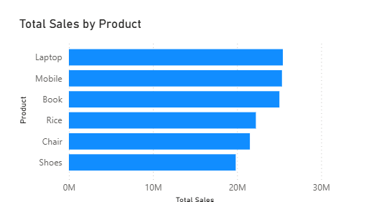
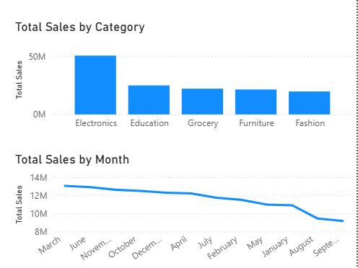
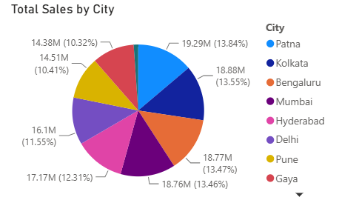
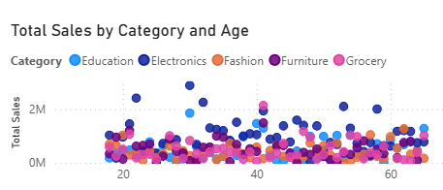
Exploratory Data Analysis
✔ Histogram – Sales Distribution
✔ Bar Chart – Sales by Category
✔ Scatter Plot – Age vs Total Sales
✔ Heatmap – Correlation Analysis
✔ Line Chart –monthly sales trends

Slide 6
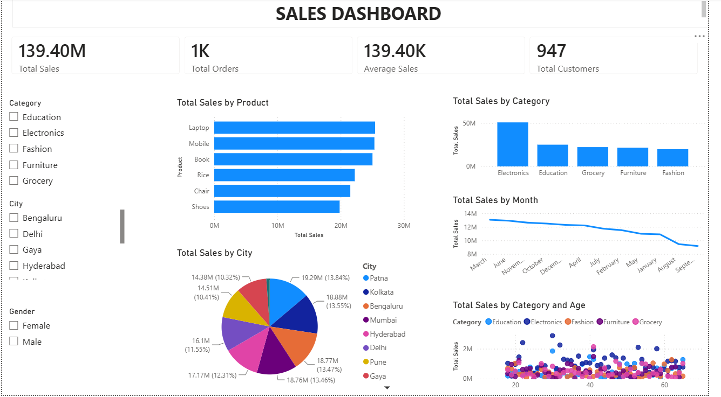
Interactive Dashboard
✔ KPI Cards
✔ Sales by Product
✔ Sales by Category
✔ Sales by City
✔ Monthly Sales Trend
✔ Scatter Plot
✔ Interactive Slicers

Slide 7
Business Insights
✔ Electronics generated the highest sales.
✔ Laptop and Mobile were top-selling products.
✔ Monthly sales fluctuated over time.
✔ Sales varied across different cities.
✔ Customer purchasing patterns differed across categories.
✔ Dashboard supports interactive analysis..

Slide 8
Hypothesis Testing
Business Question :
Is there a significant difference in average Total Sales between male and female customers?
H₀:
No significant difference
H₁:
Significant difference
Test Used:
Independent Sample t-test
Conclusion:
Reject H₀ / Fail to Reject H₀

Slide 9
Business Recommendations
✔ Increase inventory for top-selling products.
✔ Focus marketing on high-performing categories.
✔ Run promotions during low-sales months.
✔ Target customers based on city-wise analysis.
✔ Use the dashboard for business decisions.
✔ Update data regularly for better insights.

Slide 10
Conclusion
• Successfully completed the end-to-end sales data analysis project.
• Performed data cleaning, exploratory data analysis, SQL analysis, and interactive dashboard development.
• Validated a business insight using statistical hypothesis testing.
• Generated meaningful business insights and actionable recommendations. • Strengthened practical skills in Python, SQL, Excel, and Power BI.

